Slide 1
Chapter 11
Information Systems Management

Slide 2
"I Don't Know Anything About Doing Business in India."
Discuss outsourcing PRIDE development to India
Ownership of Ajit Barid (“Invincible cloud”) unknown
Successfully developed iOS for iPad
Can they do Android?
Company growing quickly, but well managed?
Uncertain security, time risks
Bite the bullet and hire own programmers?
Notes:
Goals
Use PRIDE to:
Illustrate some technical issues dilemma of offshore outsourcing:
– It can be considerably cheaper than domestic development.
– It is replete with problems and risks.
Have students make a list of all the problems they identify in scenario.

Slide 3
Study Questions
Q1: What are the functions and organization of the IS department?
Q2: How do organizations plan the use of IS?
Q3: What are the advantages and disadvantages of outsourcing?
Q4: What are your user rights and responsibilities?
How does the knowledge in this chapter help you?
Notes:
Information systems are critical to organizational success and need to be managed responsibly. The chapter surveys the management of IS and IT resources. It first discusses the major functions and the organization of the IS department. Then, it discusses planning the use of IT/IS.
Outsourcing is the process of hiring outside vendors to provide business services and related products. For our purposes, outsourcing refers to hiring outside vendors to provide information systems, products, and applications. The pros and cons, and risks of outsourcing discussed.
The chapter ends with a discussion of the relationship between users to the IS department, such as user and IS department’s rights and responsibilities.

Slide 4
Q1: What Are the Functions and Organization of the IS Department?
Plan use of IS to accomplish organizational goals and strategy
Manage outsourcing relationships
Protect information assets
Develop, operate, maintain computing infrastructure
Develop, operate, maintain applications
Notes:
Protection function is topic of Chapter 10.
Develop functions important for IS majors, but less so for other business professionals and not considered in this text.
To set stage, consider the organization of IS Department.

Slide 5
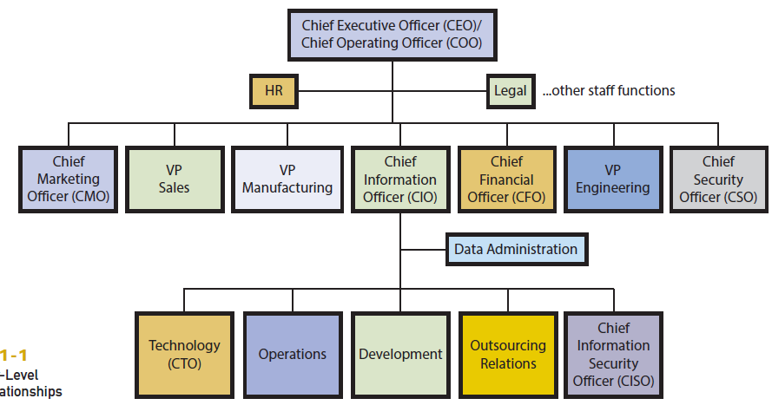
How Is the IS Department Organized?
Notes:
This figure a shows typical top-level structure and reporting relationships of a large organization.
The organizational structure varies depending on the organization’s size, culture, competitive environment, industry, and other factors.
Other common titles are vice president of information services, director of information services, and, less commonly, director of computer services.
The size and structure of the development group depend on whether programs are developed in-house.
The Data Administration staff function is to protect data and information assets by establishing data standards and data management practices and policies.

Slide 6
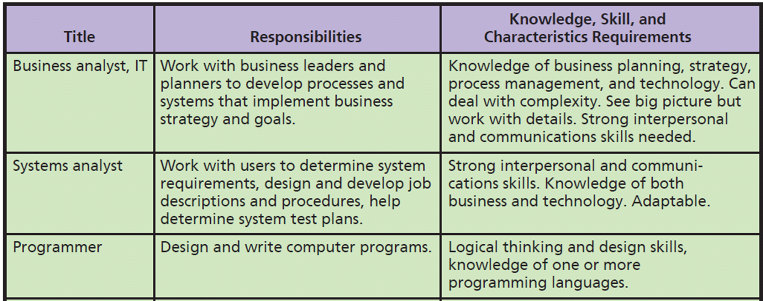
What IS-Related Job Positions Exist?
Notes:
Relate to five components of an information system.
With exception of computer technician, and possibly test QA engineer, all these positions require a 4-year degree and business knowledge or business degree, and good verbal communications and writing skills.

Slide 7
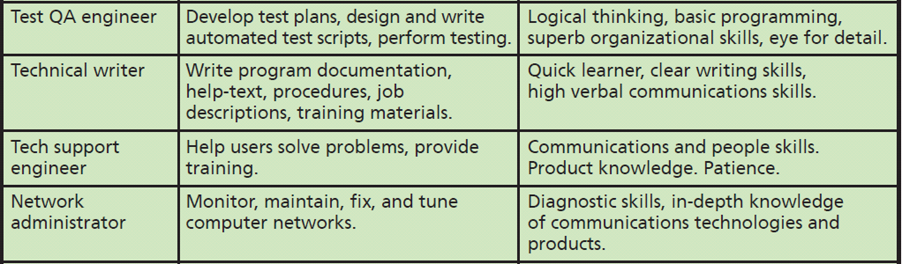
What IS-Related Job Positions Exist? (cont'd)
Notes:
Salaries for information systems jobs have a wide range. Higher salaries are for professionals with more experience, working for larger companies, and living in larger cities.

Slide 8
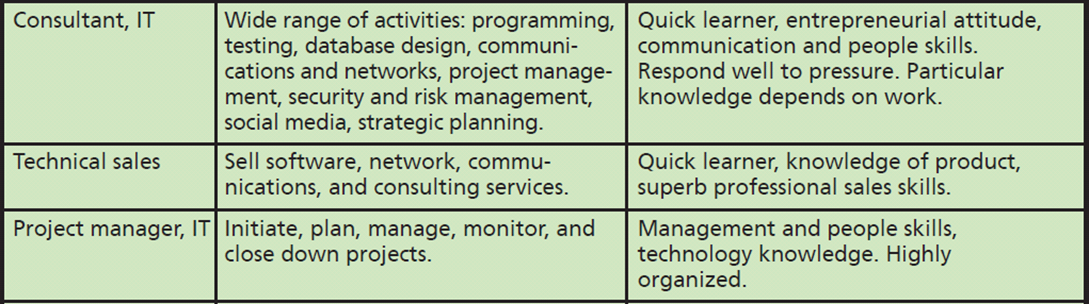
What IS-Related Job Positions Exist? (cont'd)

Slide 9
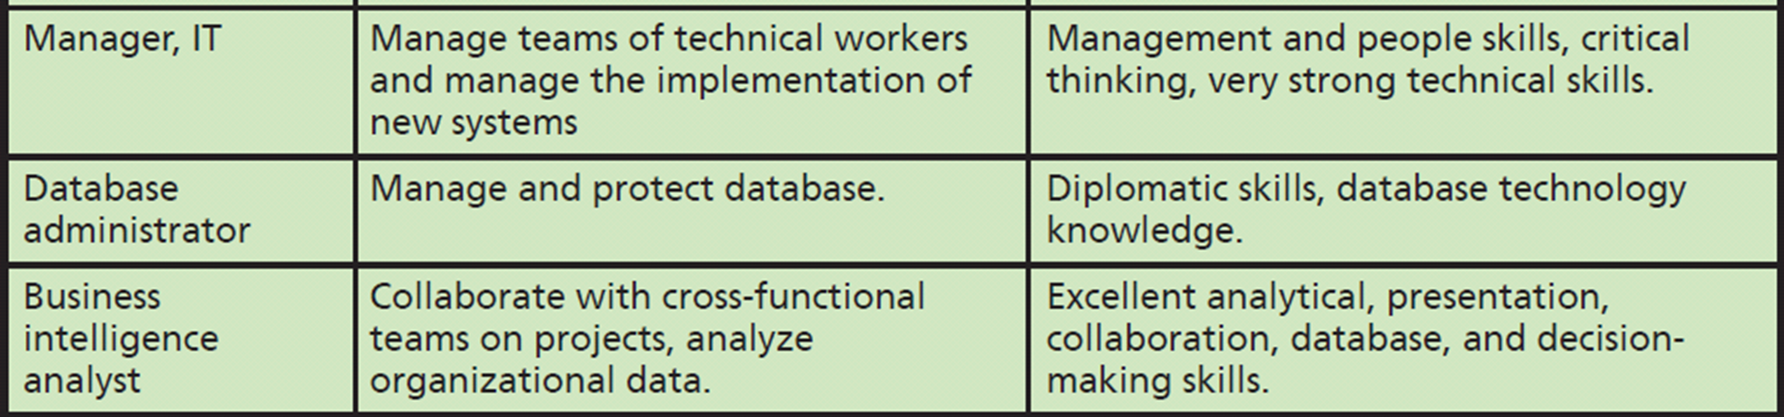
What IS-Related Job Positions Exist? (cont'd)

Slide 10
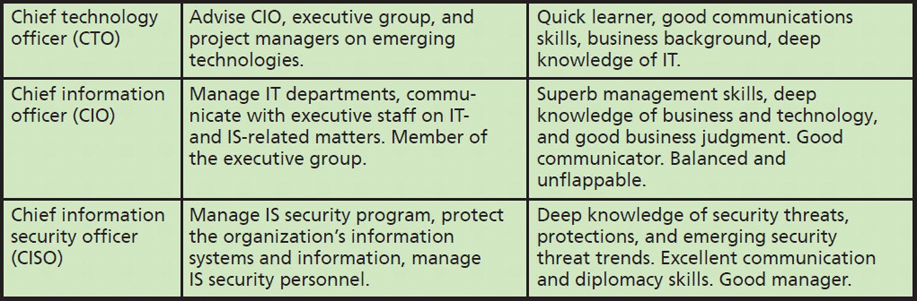
What IS-Related Job Positions Exist? (cont'd)

Slide 11
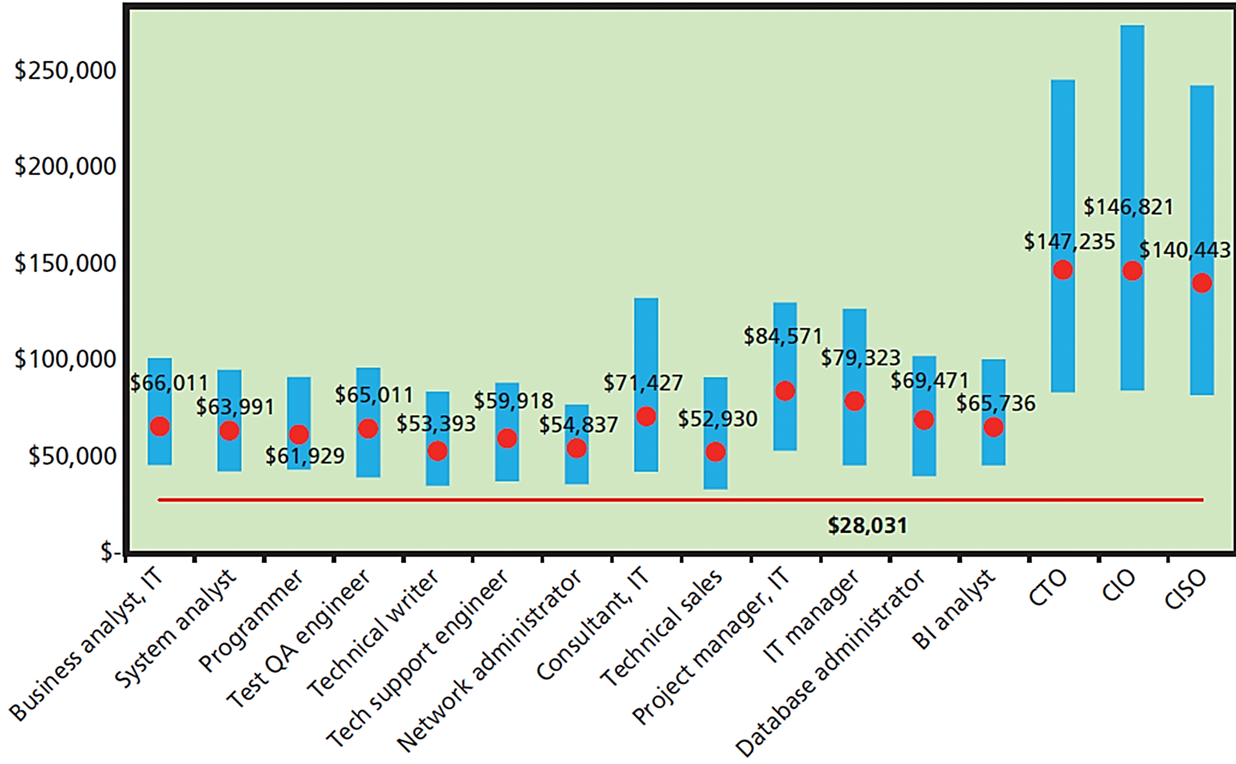
Salaries for Information Systems Jobs

Slide 12
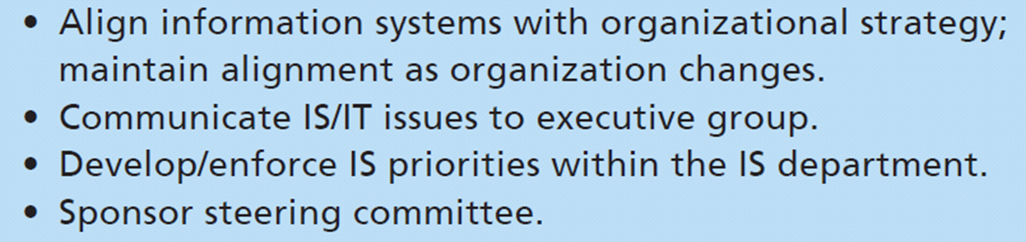
Q2: How Do Organizations Plan the Use of IS?
Notes:
All information systems must be aligned with the organization’s competitive strategy.
Maintaining alignment between IS capabilities and organizational strategy is a continual process. Without a strong CIO, IS may be perceived as drag on organization’s opportunities.
A steering committee is a group of senior managers from the major business functions that works with CIO to set IS priorities and decide among major IS projects and alternatives. IS department sets up the steering committee’s schedule, agenda and conducts meetings.

Slide 13
So What? Is James Right for the Job?
As a future user of IS department’s services, helpful to know the factors that drive standards and policies.
If you’re a manager, this knowledge will help you guide your employees behavior vis-à-vis the IS department.
James decided to use an offshore contractor. Does that influence your assessment of James?
James decided to use a cloud vendor to provide PaaS functionality. How it reflects on James’s competence?

Slide 14
So What? Is James Right for the Job? (cont’d)
How will these decisions affect:
Function and goals of the Operations group (see Figure 11-1)?
Function and goals of the Development group? What job descriptions will this group need to staff?
Function and goals of the Outsourcing Relations group?
Assume James has not specified the need for a CTO. Is this a mistake?

Slide 15
Q3: What Are the Advantages and Disadvantages of Outsourcing?
Process of hiring another organization to perform services
Any value chain business activity can be outsourced
Save costs, gain expertise
Save direct/indirect management time and attention
“Your back room is someone else’s front room.” (Drucker)
Notes:
At PRIDE Systems, building a large development and test team may be more than the company needs and require management skills that neither James nor Jared have. Outsourcing the development function saves them from needing this expertise.

Slide 16
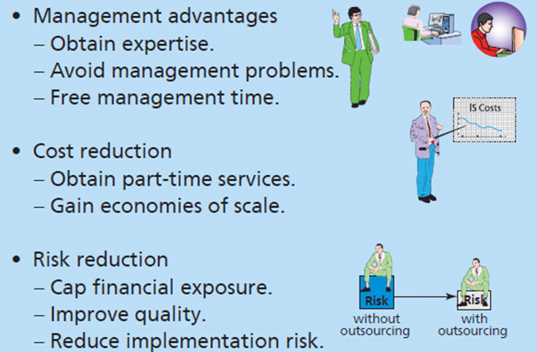
Popular Reasons for Outsourcing IS Services
Notes:
Many companies outsource portions of information systems activities. This figure lists popular reasons for doing so.
Toshio at Falcon Security has skills to manage a new product development project, but might not want to invest his time. Falcon Security has outsourced its new facilities scheduling system to the cloud.

Slide 17
Risk Reduction
Caps financial risk
Ensures quality or avoids substandard quality
Less likely to pick wrong hardware, software, network protocol, or implementing tax law changes incorrectly
Vendor’s responsible for managing risks

Slide 18
International Outsourcing
India
Large, well-educated, English-speaking, labor cost 70-80% less than US
China and other countries
Modern telephone technology and Internet-enabled service databases
Customer support and other functions operational 24/7
Notes:
With modern telephone technology and Internet-enabled service databases, a single customer service call can be initiated in United States, partially processed in India, then Singapore, and finalized in Ireland.
Amazon.com operates customer service centers in the United States, India, and Ireland.

Slide 19
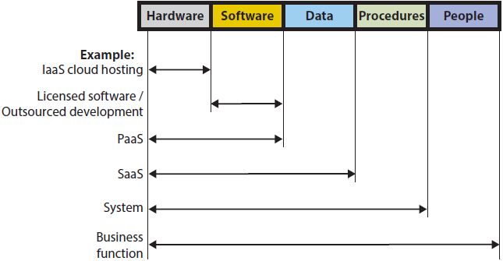
What Are Outsourcing Alternatives?
Notes:
Categories of alternatives according to information systems components and outsourcing of hardware to the cloud.
Electronic Data Systems (EDS) successful for more than 30 years as outsource vendor of hardware infrastructure.
Software as a service (SaaS) an outsourcing alternative that provides hosted applications and data storage. Salesforce.com is a typical example of a SaaS provider.
Outsource an entire system: Oracle provides entire payroll function as an outsourced service. Client company only provides employee and work information, while payroll outsource vendor does the rest.
Web storefront is a form of application outsourcing. Amazon.com provides a Web storefront for product vendors and distributors who choose not to develop their own Web presence.
Some organizations choose to outsource an entire business function. Many companies outsource to travel agencies the function of arranging for employee travel. Some outsource vendors operate offices within other company’s facilities.

Slide 20
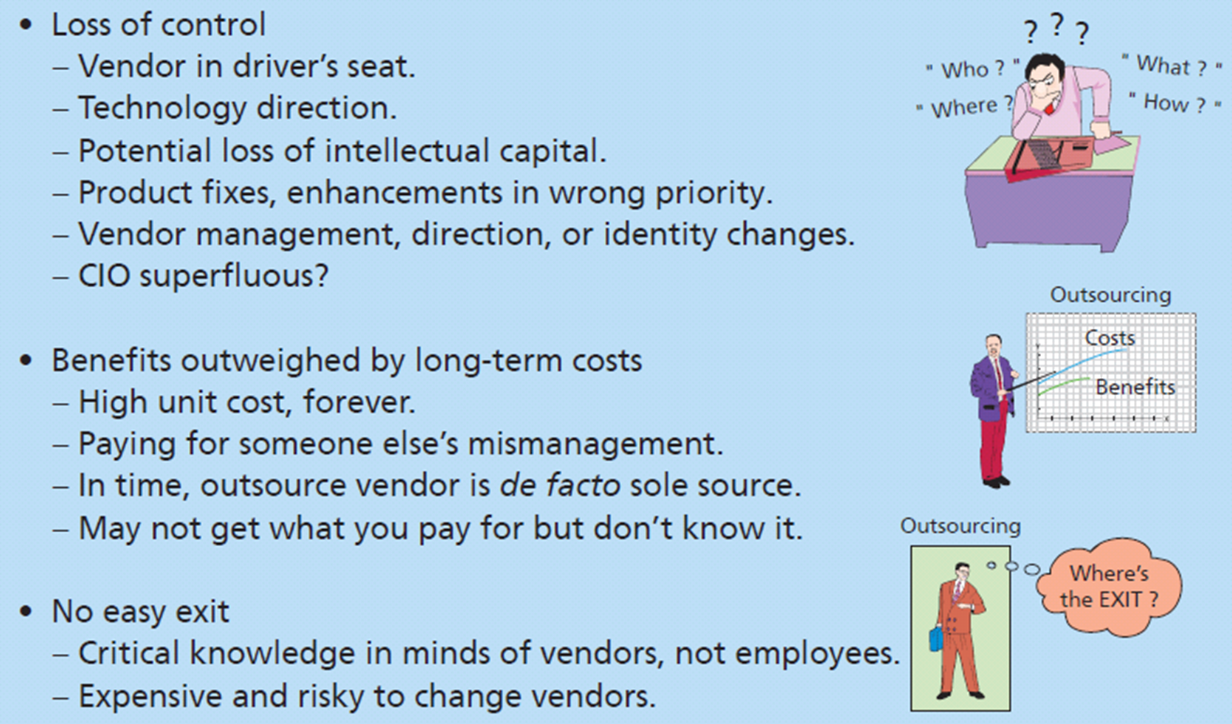
Risks of Outsourcing
Notes:
Outsourcing presents significant risks.
Loss of control over important business functions, loss of human capital and important management resources.
Difficulty in identifying or realizing benefits.
Difficulty in ending outsourcing dependencies.

Slide 21
Benefits Outweighed by Long-Term Costs
Unit fixed cost contract prevents economies of scale
Vendor defacto sole source
Changing pricing strategy
No easy exit (tightly integrated vendor)
Difficult to know if vendor well managed
Notes:
Vendor becomes defacto sole source and might increase its prices.
Vendor becomes tightly integrated such that parting company can be exceedingly risky.
Outsource vendor’s employees have gained significant knowledge of the company.
Vendor knows the server requirements in customer support, patterns of usage, and best procedures for downloading operational data into the data warehouse. Consequently, your lack of knowledge make it difficult to bring outsourced service back in-house.
Company must invest considerable work, duplication of effort, management time, and expense to change to another vendor.

Slide 22
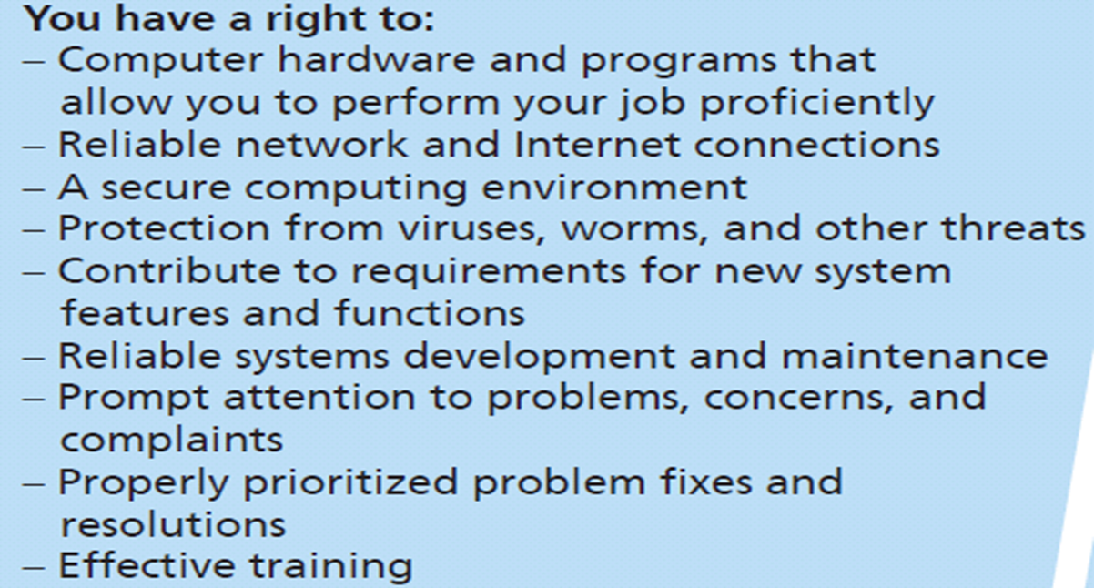
Q4: What Are Your IS Rights and Responsibilities?
Notes:
If you process huge files for data-mining applications, you have a right to the huge disks and fast processor that you need. However, if you merely receive email and access corporate Web portal, then your right is for more modest requirements.
Reliable means you can process without problems.
Organization should protect your computer and files, and you should not normally need to think about security.
Participate in requirements meetings for new applications you will use and for major changes to applications currently used.
Receive prompt attention to your problems, concerns, and complaints about information services. Right to have means to report problems, and to know your problem has been received and registered with IS department. Right to have your problem resolved, consistent with established priorities.
Training convenient to you, easy to understand and enables you to use systems to perform your job.

Slide 23
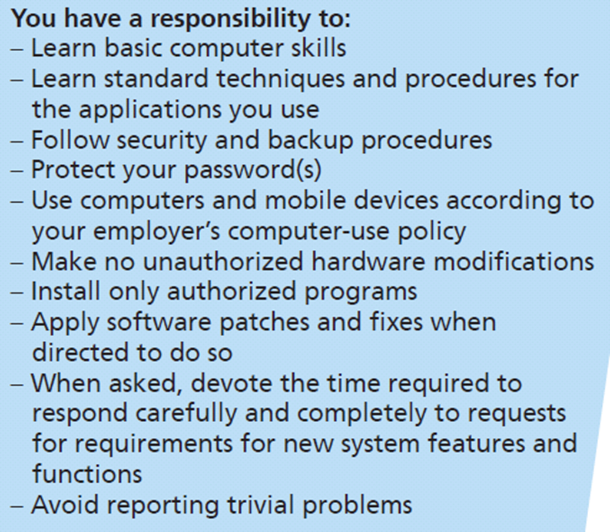
What Are Your IS Rights and Responsibilities? (cont’d)
Treat information systems professionals professionally
Notes:
Your responsibilities toward IS department and organization.
Do not expect hand-holding for basic operations. Nor expect to receive repetitive training and support for same issue.
Responsible for protecting your password(s), computer, your organization’s networks and databases.
Unauthorized modifications could interfere with automated maintenance programs for upgrading your computer and cause problems the IS department will have to fix.
Responsibility to treat information systems professionals professionally. One form of professional behavior is to learn basic computer skills to avoid reporting trivial problems.

Slide 24
How Does the Knowledge in this Chapter Help You?
Know primary responsibilities of IS department and can understand why department may implement standards and policies it does
Know planning functions of IS and how they relate to rest of organization
Know reasons for outsourcing IS services, most common and popular outsource alternatives, and outsourcing risks
Know how to be a better consumer of IS department services

Slide 25
How Does the Knowledge in this Chapter Help You? (cont’d)
Know kinds of work that must be done and the advantages, disadvantages, and choices for outsourcing work
Know the advantages and disadvantages of outsourcing software development
Knowing your rights and responsibilities will enable you to be a more effective business professional by setting reasonable expectations as to what you can expect from the IS department
Knowing what the IS department expects of you

Slide 26
Ethics Guide: Privacy vs Productivity BYOD Dilemma
New committee to provide input for company BYOD policy
Misconception: How to restrict mobile devices to improve productivity
IS folks focused security issues
Users need guidance on acceptable/unacceptable use
Suggested “configuring” people’s personal devices
Notes:
GOALS
Evaluate ethics of employee activities in terms of a particular computer-use policy.
Forewarn students that employers have right to monitor computer usage, and many do.
Develop techniques for managing employees’ computer use.
Guide focuses on the student’s role as a manager rather than as a computer user.

Slide 27
Ethics Guide: Privacy vs Productivity BYOD Dilemma (cont’d)
Company security concerns
Data theft
Malware
Employee security concerns
Personal privacy
Key loggers, monitoring software
Deleting personal files and programs/apps
Is it ethical for company to control devices employees purchased?
\

Slide 28
Guide: Is Outsourcing Fool’s Gold?
Outsourcing infrastructure advantages and disadvantages
Pay premium for services of former employees, now managed by strangers and paid by vendor
Vendor managers evaluated on how well they follow vendor’s profit-generating procedures
Turn your operation into a clone of their other clients
All critical knowledge in vendor’s employees, prohibited from going to work for you
Expensive leap away from responsibility
Notes:
GOAL
Investigate advantages and disadvantages of computer infrastructure outsourcing.
Note: This guide differs from the opening scenario because it doesn’t necessarily assume offshore outsourcing.
Background
Outsourcers get their first-level employees by hiring the ones you had. What you’re really outsourcing is middle-level management of same IT personnel you had.
No way of knowing whether the managers they supply are any better.
Paying a premium for services of former employees, now managed by strangers and paid by outsource vendor, who evaluates those managers on how well they follow outsource vendor’s profit-generating procedures.

Slide 29
Active Review
Q1: What are the functions and organization of the IS department?
Q2: How do organizations plan the use of IS?
Q3: What are the advantages and disadvantages of outsourcing?
Q4: What are your user rights and responsibilities?
How does the knowledge in this chapter help you?

Slide 30
Case Study 11: iApp$$$$ 4 U
Ideas only as good as their implementation
How can you go getting iOS app developed?
Cost of creating mobile commerce app = $150K
Programming time cost excluding time for specifying requirements, designing user interface, testing, Apple review process
Notes:
What is value of that idea? According to Raven Zachary, no professional iPhone developer will take equity or promise of future revenue sharing in exchange for cash. There is too much cash-paying work. Ideas are only as good as their implementation.

Slide 31
What Are Your Options?
Do as much as you can yourself
Skill in Objective-C or Apple’s Swift
Determine how many SDLC stages you can do yourself
Prototype user-interface
Develop a test plan skeleton
Perform some testing tasks yourself
Outsource to US or EU programmer ($30k)
Notes:
Goal:
Give students some understanding options for real-world outsourcing iOS app development.
How can you go about getting your iOS application developed?

Slide 32
What Are Your Options? (cont’d)
Outsource off-shore or hire a computer-science student
Students undependable?
Elance.com – clearing house for iOS development experts.
Lists developers and locations, typical costs, ratings by previous customers
Hire developers in India, Russia, the Ukraine, Romania, and other countries ($2000+)
Break big app into smaller, easily doable apps
Notes:
Check Elance.com a clearing house for iOS development experts. Lists developers, their locations, typical costs, and ratings of previous customers

